Slide 1
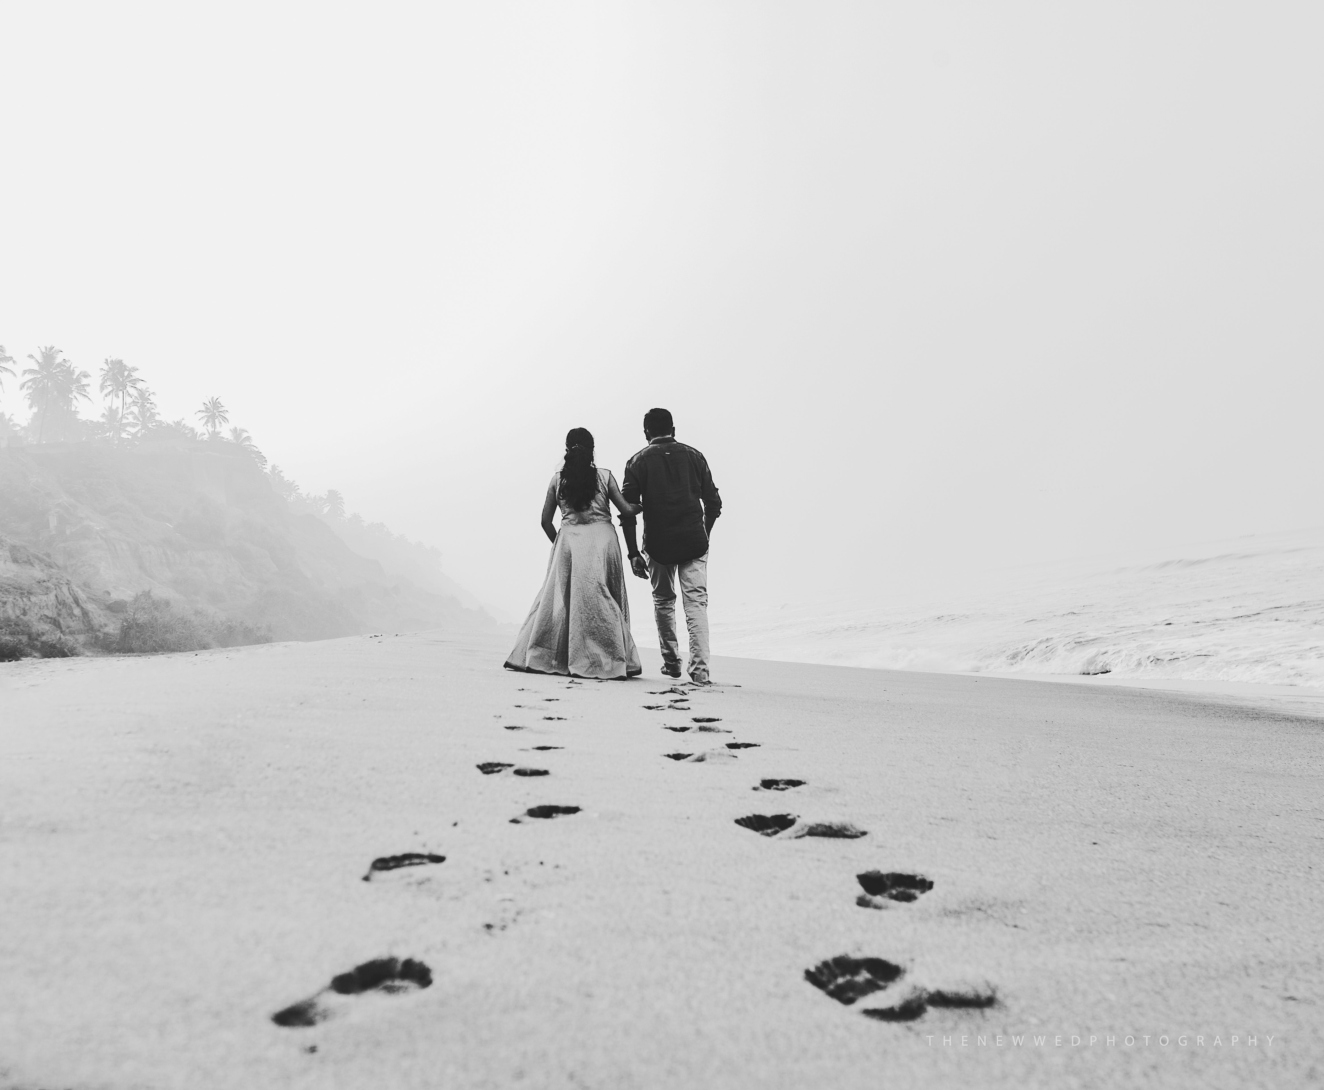
WELCOME TO THE WEDDING OF
Sophia
Robert
and
23.07.2025
THANK YOU FOR CELEBRATING WITH US!

